Slide 1
Time Series Project Texas Covid-19 Case Prediction
Cameron Stewart & Ana Elsa Glaser

Slide 2
Data Description
COVID-19 Case Data
Source: Texas Department of State Health Services
Date Range: March 2020 – present
https://www.arcgis.com/apps/dashboards/45e18cba105c478697c76acbbf86a6bc
Vaccination Doses Administered
Texas Department of State Health Services
Date Range: December 2020 – present
https://www.arcgis.com/apps/dashboards/45e18cba105c478697c76acbbf86a6bc
COVID Test Data
Source: Texas Department of State Health Services
Date Range: September 2020 – present
https://www.arcgis.com/apps/dashboards/45e18cba105c478697c76acbbf86a6bc
Google Mobility Data
Google
Date Range: February 2020 – present
https://www.google.com/covid19/mobility/

Slide 3
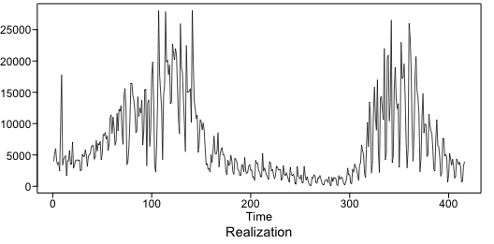
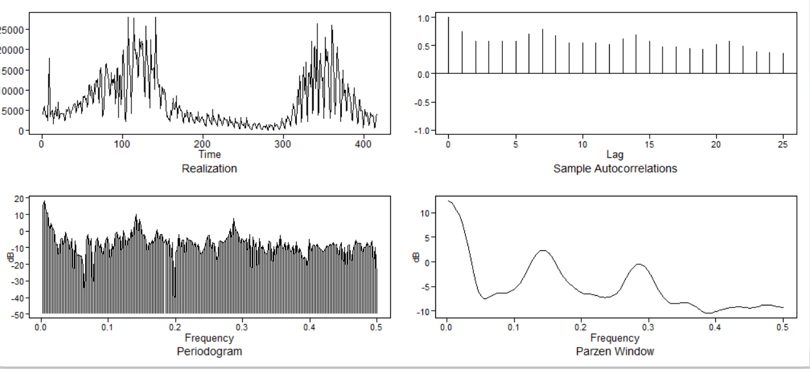
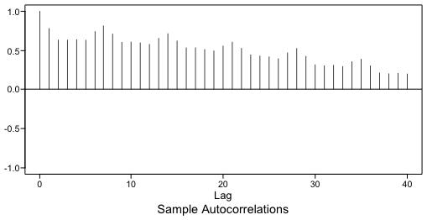
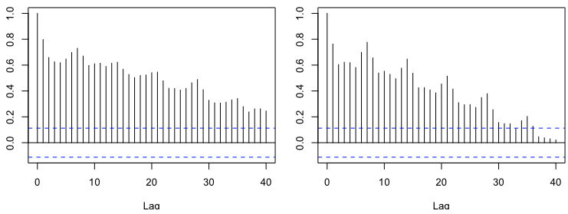
Texas Covid Case Data
First and Second Half ACFs

Slide 4
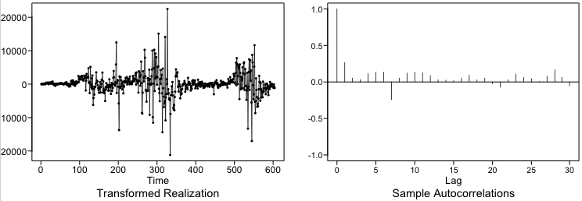
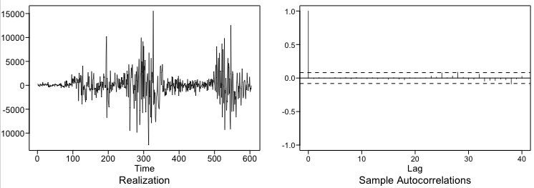
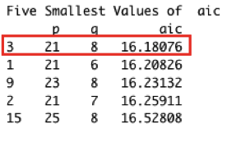
Model 1 - Seasonal Model
Remove Seasonality of 7 Days

Slide 5
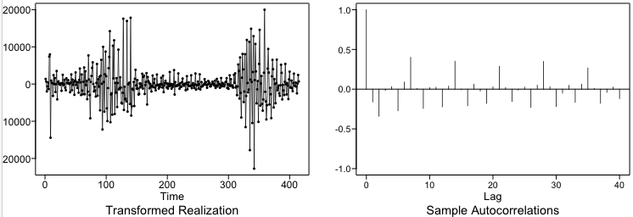
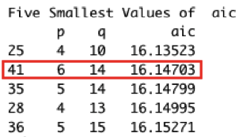
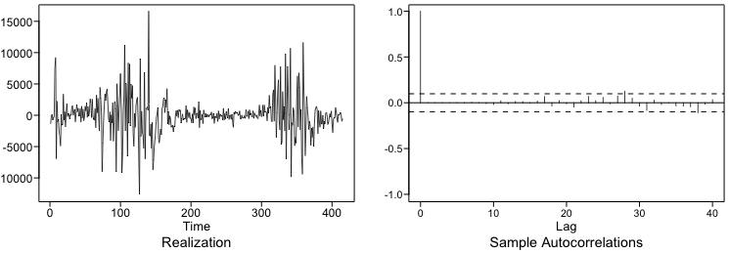
Model 2 - Differencing Model
Remove (1-B) term

Slide 6
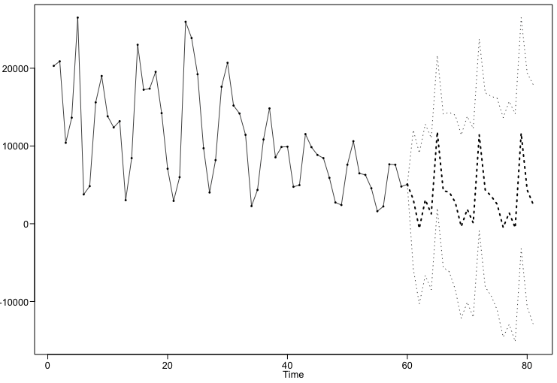
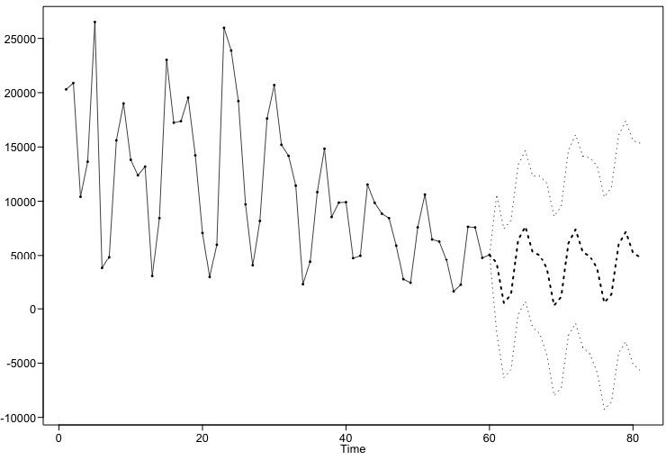
Rolling Window RMSE Comparison
ARIMA(21,0,8) with s = 7
ARIMA(6,1,14)
Rolling Window RMSE:
Short Term Forecast – 7 Days
3457 Cases
Long Term Forecast – 21 Days
4271 Cases
Rolling Window RMSE:
Short Term Forecast – 7 Days
2981 Cases
Long Term Forecast – 21 Days
3806 Cases
RMSE LOWER

Slide 7
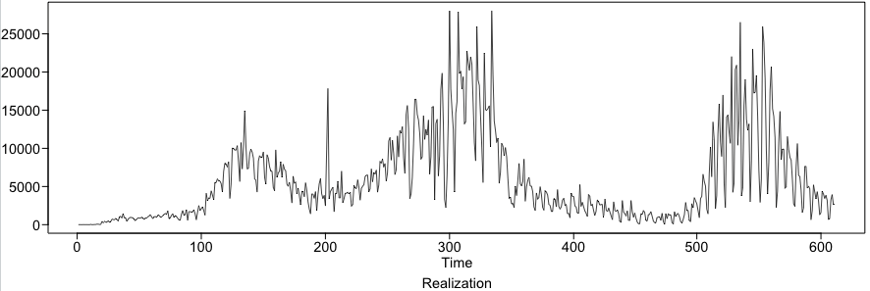
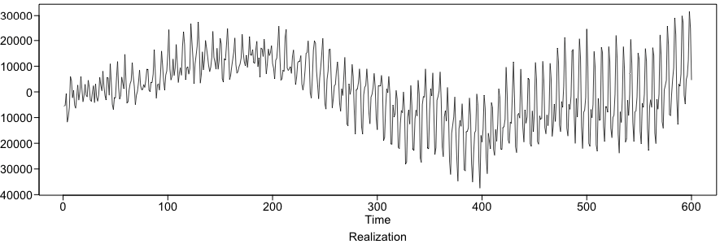
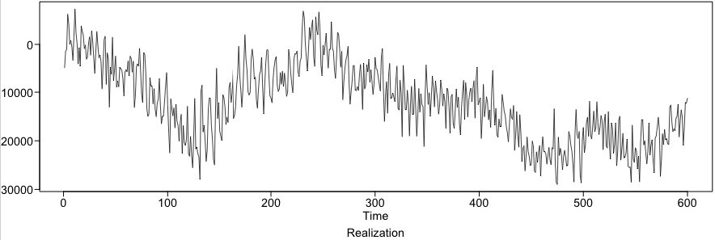
Compare Randomly Generated Plots
Original Realization
ARIMA(21,0,8)
with s = 7
ARIMA(6,1,14)

Slide 8
Strategy for the rest of the analysis
Investigate how to deal with periods of high realization variability
Moving Average Smoothing
Ensemble Modeling
Explore models with regressors such as:
Google Mobility Data
Vaccination Doses
Covid Tests Taken
Develop forecasts with models such as:
Vector AR Models
Neural Network Models

Slide 9
THANK YOU!

Slide 10
Youtube Link: https://youtu.be/jST1Y_r0Z64

